Slide 1
Lecture-4 Clipping

Slide 2
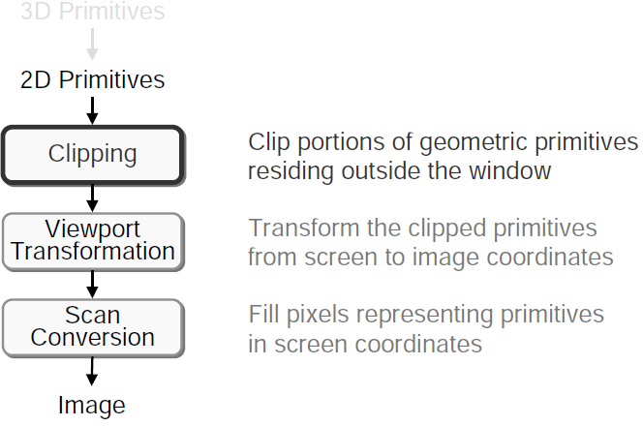
2D Rendering Pipeline

Slide 3
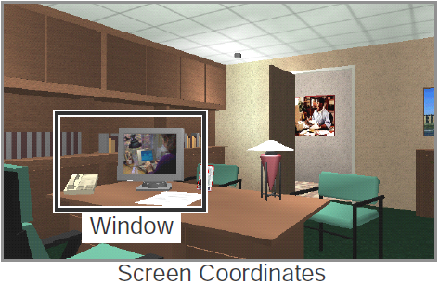
Clipping
Avoid drawing parts of primitives outside window
Window defines part of scene being viewed
Must draw geometric primitives only inside window

Slide 4
What do we need clipping for?
we have a rectangular screen
shows a section of 3D world (view volume)
clipping removes invisible parts
avoid processing – view volume clipping
avoid raster conversion – viewport clipping
avoid color computation – viewport clipping
→ faster rendering!

Slide 5
Basic Clipping Objectives
simple case: clip lines vs axis-aligned 2D rectangle
for each line, decide if it
can be discarded
can be fully drawn
has to be further examined
need high efficiency! (millions of lines)

Slide 6
Simple Clipping Algorithm
classify line segment endpoints:
both inside rectangle → draw line segment
one inside, one outside → find intersection → draw inside part
both outside → not clear (yet) → line could be partially inside

Slide 7
Clipping
Cohen-Sutherland Algorithm

Slide 8
Cohen-Sutherland Algorithm
define 9 regions with binary codes
each bit records position of x or y
1st bit: > y_{max}
2nd bit: < y_{min}
3rd bit: > x_{max}
4th bit: < x_{min}
1001
1000
1010
y_{max}
0001
0000
0010
y_{min}
0101
0100
0110
_{Xmin}
_{Xmax}

Slide 9
Cohen-Sutherland Algorithm
classify all endpoints according to these bit codes
use bit operations for efficient testing while(true) if ((code(P₁) | code(P₂)=0) { accept(); break; } else if (code(P₁) & code(P₂)!=0) { reject(); break; } else intersect_segment();
1001
1000
1010
0001
0000
0010
0101
0100
0110

Slide 10


Finding Intersection Point

Slide 11
Cohen-Sutherland Algorithm
Example 1
code(P₁) = 0000
code(P₂) = 0000
first test: code(P₁) | code(P₂) = 0 → accept, draw, done
1001
1000
1010
0001
0000
0010
0101
0100
0110

Slide 12
Cohen-Sutherland Algorithm
Example 2
code(P₁) = 0001
code(P₂) = 0101
first test: code(P₁) | code(P₂) = 0101 → no conclusion
second test: code(P₁) & code(P₂) = 0001 → reject, draw nothing, done
1001
1000
1010
y_{max}
0001
0000
0010
y_{min}
0101
0100
0110
_{Xmin}
_{Xmax}

Slide 13
Cohen-Sutherland Algorithm
Example 3
code(P₁) = 1000
code(P₂) = 0010
first test: code(P₁) | code(P₂) = 1010 → no conclusion
second test: code(P₁) & code(P₂) = 0000 → intersect! → replace P₁,P₂ with new points, repeat
1001
1000
1010
y_{max}
0001
0000
0010
y_{min}
0101
0100
0110
_{Xmin}
_{Xmax}

Slide 14
Cohen-Sutherland Algorithm
Example 4
code(P₁) = 0100
code(P₂) = 0010
first test: code(P₁) | code(P₂) = 0110 → no conclusion
second test: code(P₁) & code(P₂) = 0000 → intersect! → replace P₁,P₂ with new points → done
1001
1000
1010
0001
0000
0010
0101
0100
0110

Slide 15
Cohen-Sutherland Algorithm
Finding intersections
If bit 1 is 1,
intersect with line y = y_{max}
Else If bit 2 is 1,
intersect with line y = y_{min}
Else If bit 3 is 1,
intersect with line x = x_{max}
Else If bit 4 is 1,
intersect with line x = x_{min}
1010
1001
1000
A
y_{max}
A₁
0001
0000
A₂
0010
y_{min}
B₁
0101
0100
B
0110
_{Xmin}
_{Xmax}

Slide 16
Thank you

